Slide 1
Modelling and Forecasting Seasonal Time Series using the ARMA-version of the Berlin Method
Jing Ma
Prof. Dr. Yuanhua Feng
Faculty of Business Administration and Economics
University of Paderborn

Slide 2
Agenda
Introduction
Berlin Method
Semiparametric Regression Model with ARMA Errors and Seasonality
Bandwidth Selection: Plug-In
Forecasting
Application
Conclusion

Slide 3
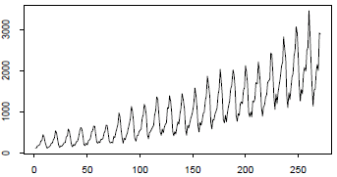
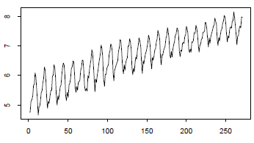
Introduction: Seasonal Time Series
Many time series in the practice have a deterministic trend or a periodic component (called seasonality) due to economic development, business cycle or some natural facts, e.g. we do not eat so many ice creams in the Winter .
An example:
Monthly UK-Tourism overseas expenditure, Jan 1980-Jul 2002
Log-transform of the original data

Slide 4
Berlin Method (Berliner Verfahren)
In Germany, the decomposition and the seasonal adjustment of economic time series with the BV have a long tradition.
In the late 1960s, BV was developed by the Berlin Technical University and the German Institute for Economic Research. Its fourth version is being applied by the German Federal Statistical Office since 1983.
The method assumes a series to be additively composed by four components, namely trend, seasonal, calendar and residual.
  trend fluctuations: technological progress, population growth
  seasonal fluctuations: climatic conditions
  calendar fluctuations: various weekdays, public holidays
  residual fluctuations: strikes, natural disasters

Slide 5
Berlin Method
The trend component is approximated by a polynomial of order 3, while the seasonal component is approximated by 11 trigonometric functions for monthly series(Eurostat.1998):
Advantages:
Speed of calculations is quick.
Applying does not require user training or expert knowledge.
Disadvantages:
It is impossible for forecasting.
The bandwidth is fixed and chosen in advance.

Slide 6
Semiparametric Regression Model with ARMA Errors and Seasonality
An equidistant time series Yt follows an additive components model:
The residual Zt can be estimated by a stationary ARMA(p, q) model
with summable autocovariances:
Around a point t0 G can be locally modeled by a polynomial of order p assuming that it is at least (p+1)-times differentiable:
S can be locally modeled by a Fourier series:

Slide 7
Semiparametric Regression Model with ARMA Errors and Seasonality
The locally weighted estimators are obtained by solving the least square problem:
leads to the solutions:

Slide 8
Asymptotic Properties
A 1: h 0 and nh ∞ as n ∞.
A 2: G is at least k(=p+1) times continuously differentiable.
A 3: S is exactly periodic with period s.
MASE:
The asymptotically optimal bandwidth, which minimizes MASE is given by
with unknown parameters : V and

Slide 9
Bandwidth Selection: Plug-In
Estimation of variance:
i.i.d. errors(4 iterations): seasonal-difference-based method
ARMA errors(> 4 iterations):
where
Estimation of I:
k-th derivative of G can be estimated with a polynomial order of pI and a bandwidth hI with pI >k and pI -k odd. Usually, pI=k+1.
Then I can be estimated by

Slide 10
Forecasting
The point forecasts model is defined by(k=1,…,12 months)
The forecasts of trend: increase according to linear extrapolation
The forecasts of seasonality: use estimates of the last 12 months
The forecasts of residual:

Slide 11
Application
Monthly international airline passengers from January 1949 to December 1962 ( Point forecasts for one year)
Australia employed persons from February 1978 to April 1991 ( Point forecasts for one year)
Total takings from accommodation from January 1980 to June 1995
Monthly Australian imports from Japan from July 1965 to October 1993
Total number of room nights occupied from January 1980 to June 1995
Monthly Australian sales of redwine from January 1980 to July 1995
US monthly sales of chemicals from January 1971 to December 1991

Slide 12
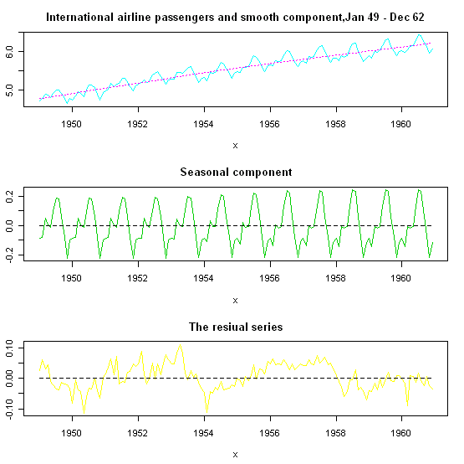
Example 1

Slide 13
Number of observations | 144
Number of iteration | 10
h | 56
2h+1 | 113
VarD | 0.0004360177
VarS | 0.008004573
p q | 0 | 1
0 | -508.9748 | -559.2373
1 | -604.3391 | -608.4435
2 | -608.7617 | -603.8375
3 | -603.8309 | -603.6565
4 | -598.8709 | -598.8729
5 | -596.8050 | -591.8418
 | ar1 | ar2 | intercept
Coefficients | 0.5294 | 0.2523 | 0.0047
s.e. | 0.0803 | 0.0809 | 0.0104
BIC: p=2, q=0.
AR(2) model
The selected best model is AR(2) model:

Slide 14
The forecasts model:
For k=1:
 | K=1 | K=2 | K=3 | … | K=12
 | 6.2268 | 6.2357 | 6.2446 | … | 6.3247
 | -0.0857 | -0.1428 | -0.0089 | … | -0.1149
 | -0.0236 | -0.0202 | -0.0157 | … | 0.0007
Σ | 6.1174 | 6.0727 | 6.2201 | … | 6.2106
Forecasts of trend, seasonality, residual and the sum of them for one year

Slide 15
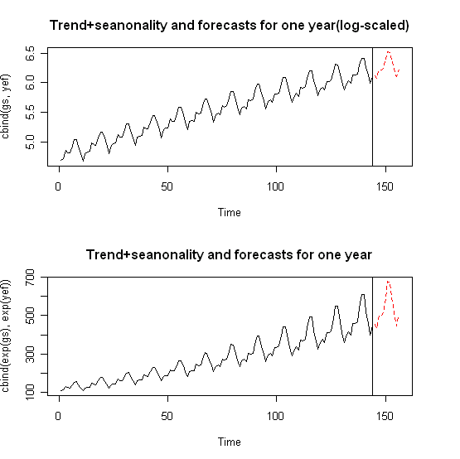
The sum of trend and seasonality with forecasts for one year (log-scaled and exponential)

Slide 16
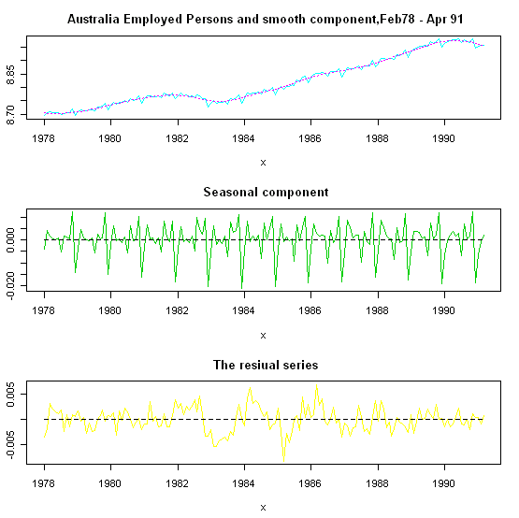
Example 2

Slide 17
Number of observations | 159
Number of iteration | 8
h | 18
2h+1 | 37
VarD | 6.961188e-06
VarS | 1.722117e-05
p q | 0 | 1
0 | -1469.673 | -1489.311
1 | -1501.066 | -1500.433
2 | -1500.912 | -1495.886
3 | -1495.902 | -1490.860
4 | -1490.960 | -1505.272
5 | -1486.099 | -1502.386
 | ar1 | intercept
Coefficients | 0.4544 | 0e+00
s.e. | 0.0708 | 3e-04
BIC: p=4, q=1: ARMA(4,1) model
p=1, q=0: AR(1) model
The fitted AR(1) model is defined by:
Notes:
However,we only consider AR model for simplicity,

Slide 18
The forecasts model:
For k=1:
 | K=1 | K=2 | K=3 | … | K=12
 | 8.9482 | 8.9440 | 8.9398 | … | 8.9020
 | 0.0040 | 0.0016 | 0.0031 | … | 0.0023
 | 0.0004 | 0.0002 | 6.1060e-05 | … | -2.1354e-05
Σ | 8.9525 | 8.9457 | 8.9429 | … | 8.9043
Forecasts of trend, seasonality, residual and the sum of them for one year

Slide 19
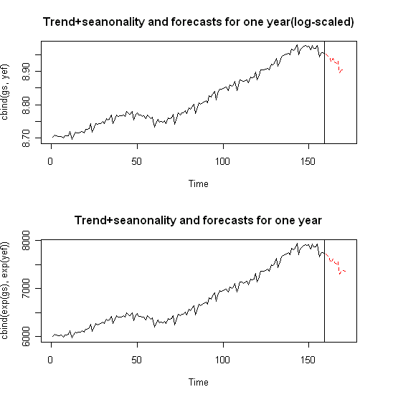
The sum of trend and seasonality with forecasts for one year (log-scaled and exponential)

Slide 20
Conclusion
Decomposing seasonal time series into trend, seasonality and residual has a long tradition.
The trend and seasonality can be estimated by locally weighted regression, while the residual can be modeled by an ARMA process, so the whole model is said to be a semiparametric model.
The asymptotically optimal bandwidth is obtained by minimizing the mean averaged squared error.
Another focus is the short-term forecasting. Trend increases according to linear extrapolation, seasonality follows the last 12 months estimates, and residuals are based on the point predictions procedure for ARMA model.
20

